Slide 1
Inverted Indexing

Slide 2
Introduction
Web search is a quintessential large-data problem.
For a given short described query, system should returns the relevant web objects. → data is more..
Web search or full text search depends on a data structure called inverted index, which given a term provides access to the list of documents that contain the term.
Given a user query, the retrieval engine uses the inverted index to score documents that contain the query terms with respect to
some ranking model,
taking into account features such as term matches, term proximity, attributes of the terms in the document.
the hyperlink structure of the documents

Slide 3
Introduction
Web search problem breaks down into three major components:
Gathering the web content (crawling)
Construction of inverted index (indexing)
Ranking the documents given a query (retrieval)
Indexing is a bath process runs periodically, it depends on crawler design

Slide 4
Web Crawling
Crawling and indexing have similar characteristics:
resource consumption is high
These are operated in offline.
Both need to scalable and efficient
Retrieval is different from these:
spikey, variability is high,
quick response is a requirement,
many concurrent users,
operate in online ;

Slide 5
Web Crawling
Before building inverted indexes, we must first acquire the document collection over which these indexes are to be built.
Acquiring web content requires crawling .
It is the process of traversing the web by repeatedly following hyperlinks and storing downloaded pages for subsequent processing.
This process is quite simple to understand:
It start by populating a queue with a “seed” list of pages.
The crawler downloads pages in the queue, extracts links from those pages to add to the queue, stores the pages for further processing
This process repeats
Effective and efficient web crawling is far more complex

Slide 6
Issues with web crawler components
issues that real-world crawlers must contend with:
A web crawler must practice good “etiquette" and not overload web servers.
Should give order priority to unvisited pages.
Web crawler is a distributed application runs on cluster. So possibility of downloading pages multiple times and need to ensure data consistency. Hence it needs a mechanisms for coordination and load-balancing.

Slide 7
Issues with web crawler components
issues that real-world crawlers must contend with:
Web content changes, but with different frequency depending on both the site and the nature of the content.
A web crawler needs to learn these update patterns to ensure that content is reasonably current.
The web is full of duplicate content. The problem
is compounded by the fact that most repetitious pages are not exact duplicates but near duplicates. It is desirable during the crawling process to identify near duplicates and select the best exemplar to index.
The web is multilingual. There is no guarantee that pages in one language only link to pages in the same language. it is important to identify the language on a page.

Slide 8
Inverted Index
An inverted index consists of postings lists, one associated with each term that appears in the collection.
A postings list is comprised of individual postings, each of which consists of a document id and a payload – information about occurrences of the term in the document.
The most common payload is term frequency.

Slide 9
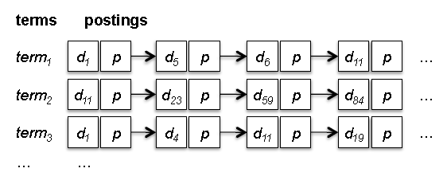

Inverted Index

Slide 10
Inverted Index
For a given query, retrieval involves fetching postings lists associated with query terms and traversing the postings to compute the result set.
Simple case:
Boolean retrieval involves set operations on posting lists.
At the end, the top k documents are then extracted to yield a ranked list of results for the user.
There are many optimization strategies for query evaluation that reduce the number of postings a retrieval engine must examine.

Slide 11
Inverted Indexes
Regular index: Document → terms
Inverted index: term→documents
Example:
term1 → {d1,p}, {d2, p}, {d23, p}
term2 → {d2, p}. {d34, p}
term3 → {d6, p}, {d56, p}, {d345, p}
Where d is the doc id, p is the payload (example for payload: term frequency… this can be blank too)

Slide 12
Retrieval
Once the inverted index is developed, when a query comes in, retrieval involves fetching the appropriate docs.
The docs are ranked and top k docs are listed.
It is good to have the inverted index in memory.
If not , some queries may involve random disk access for decoding of postings.
Solution: organize the disk accesses so that random seeks are minimized.

Slide 13
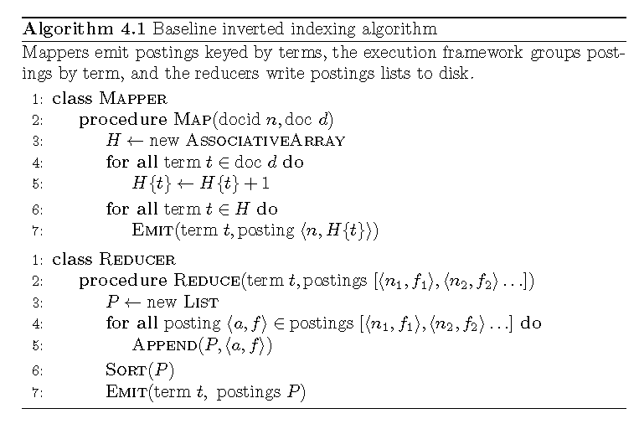
Pseudo Code

Slide 14
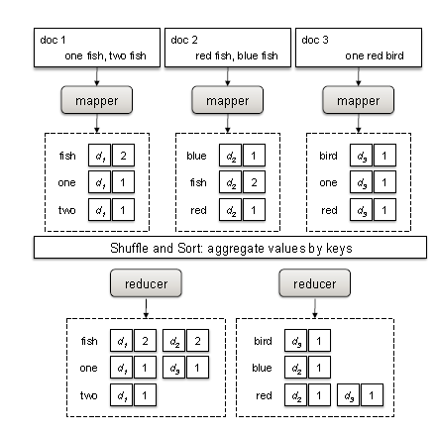
Illustration of the baseline inverted indexing algorithm in MapReduce

Slide 15
Revised Baseline inverted indexing
Problems:
scalability bottleneck → the algorithm assumes that there is sufficient memory to hold all postings associated with the same term.
Since the basic MapReduce execution framework makes no guarantees about the ordering of values associated with the same key, the reducer first buffers all postings and then performs an in-memory sort before writing the postings to disk.
However, as collections become larger, postings lists grow longer, and at some point in time, reducers will run out of memory.
Solutions:
Let the MapReduce runtime do the sorting.

Slide 16
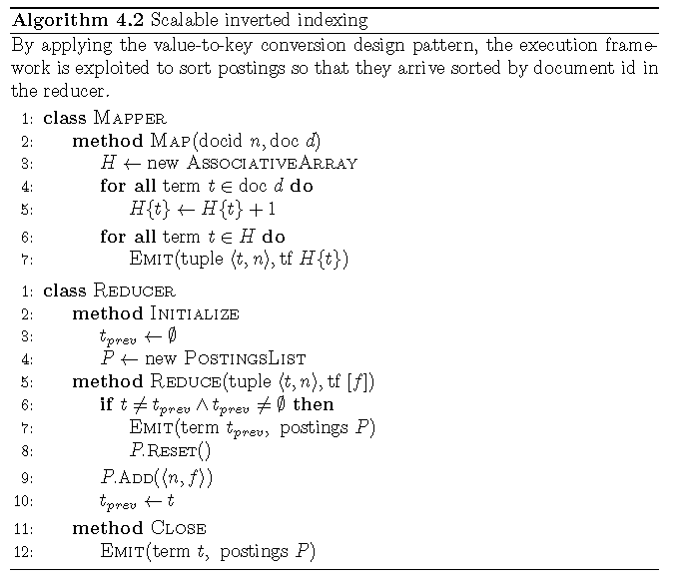
Pseudo code for revised baseline indexing

Slide 17
Revised Implementation
Issue: MR does not guarantee sorting order of the values.. Only by keys
So the sort in the reducer is an expensive operation esp. if the docs cannot be held in memory.
Lets check a revised solution
(term t, posting<docid, f>) to
(term<t,docid>, tf f)

